Slide 1




Slide 2


ASME IDETC2023 Hackathon:
Automating Material Selection for Product Design
Lequn Chen
Contact: chen1470@e.ntu.edu.sg
Advanced Remanufacturing and Technology Centre (ARTC), A*STAR, Singapore
Nanyang Technological University, Singapore
Notes:
Good afternoon, professors, and distinguished guests. My name is Lequn, and I am a PhD candidate from Nanyang Technological University. Today, I’m glad to present my paper, "Multimodal Sensor Fusion For Real-time Location-dependent Defect Detection In Laser-directed Energy Deposition"

Slide 3
01
Dataset Analysis
02
Methodology
CONTENTS
03
Results and Discussion
04
Future Works
Notes:
My presentation will follow this outline: introduction and background information, including the research gaps and objectives, the proposed methodologies and preliminary results and discussions, and future research directions.

Slide 4
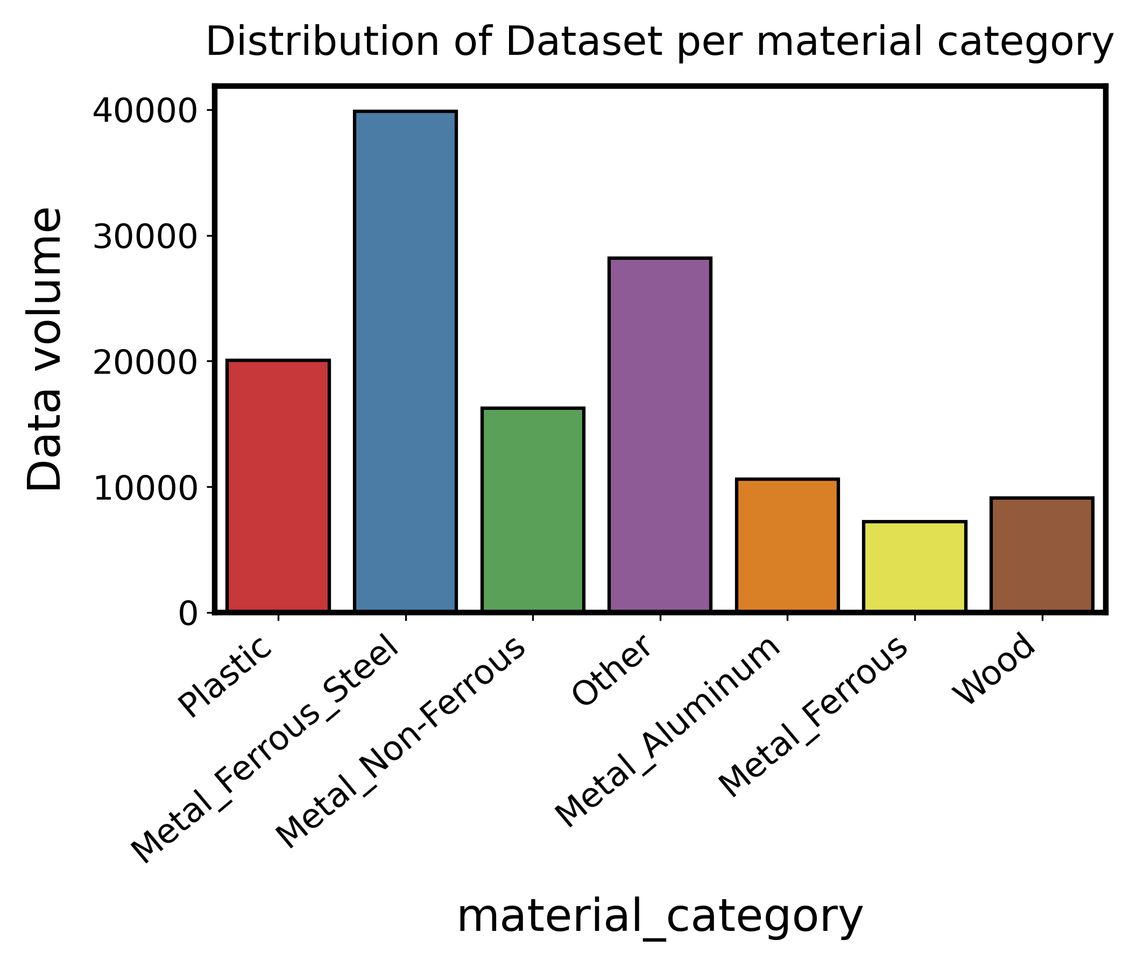
1. Dataset Analysis
Notes:
Dataset is imbalanced
Need to consider this factor during the modelling process.

Slide 5
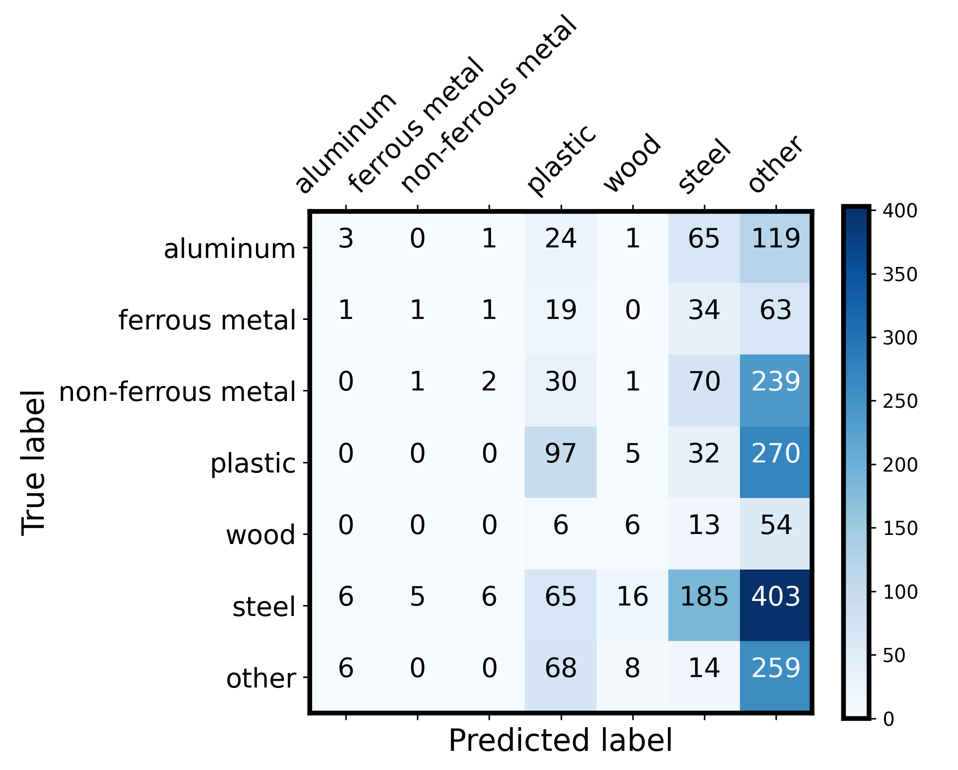

Slide 6
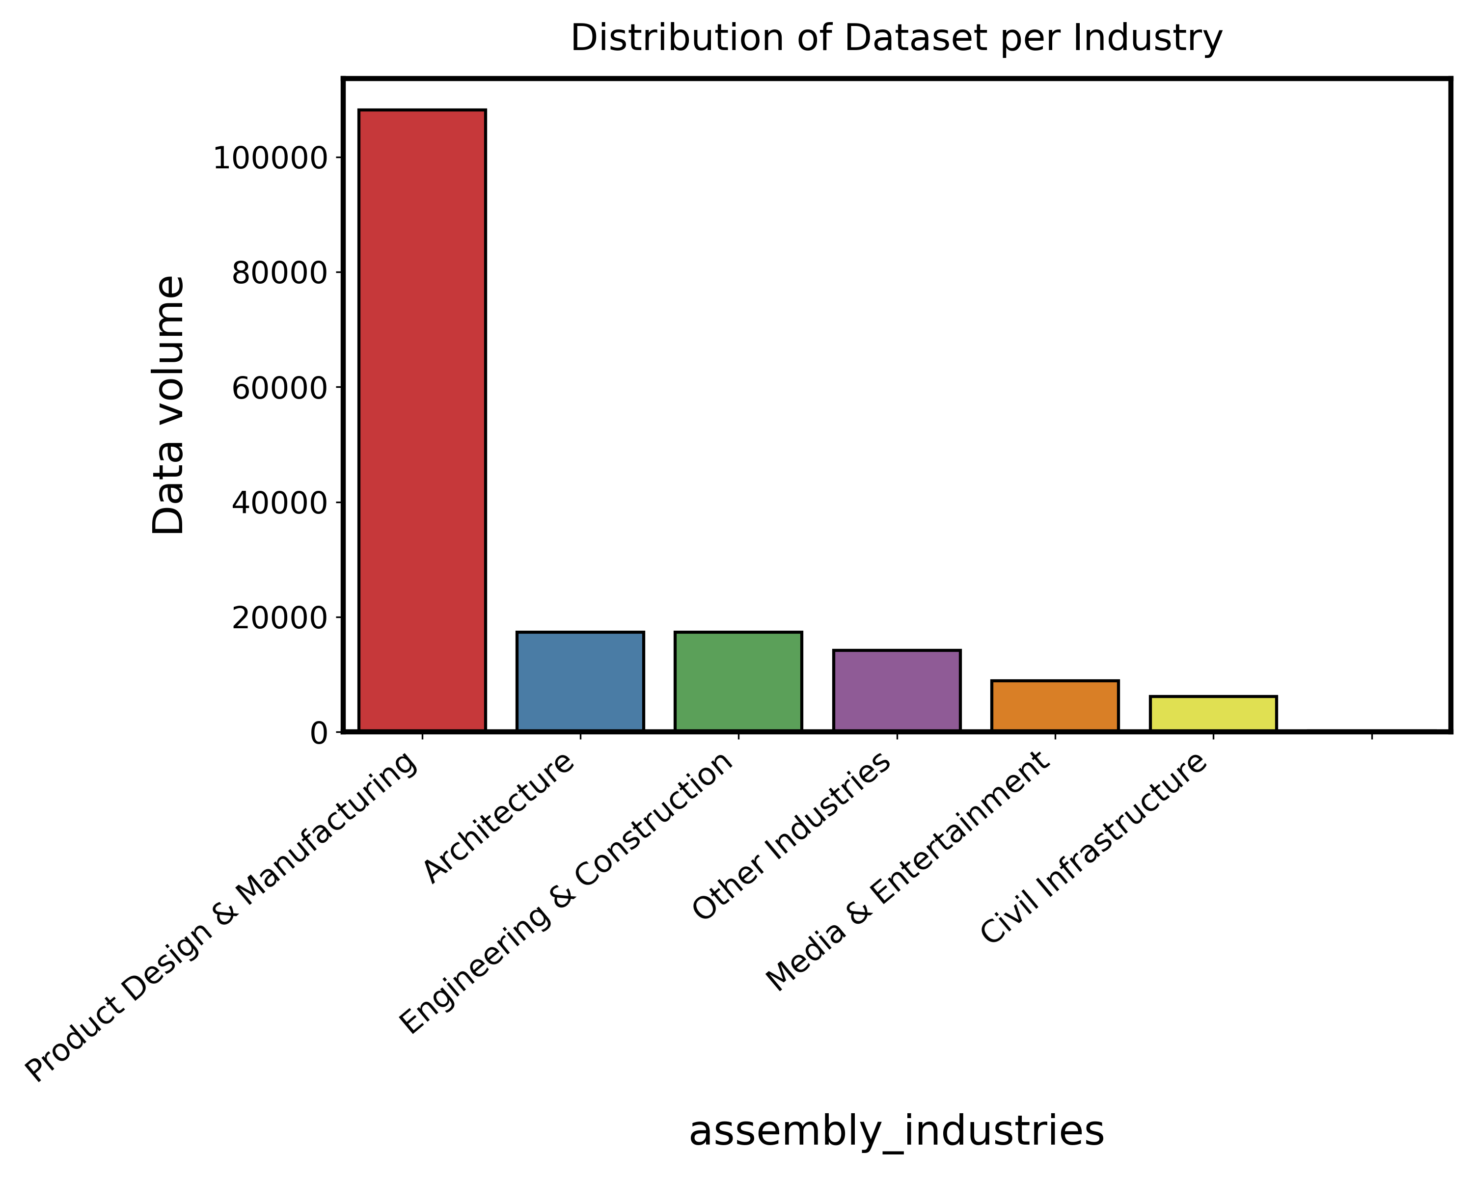
1. Dataset Analysis

Slide 7
1. Dataset Analysis
Notes:
Missing data exist assembly density

Slide 8
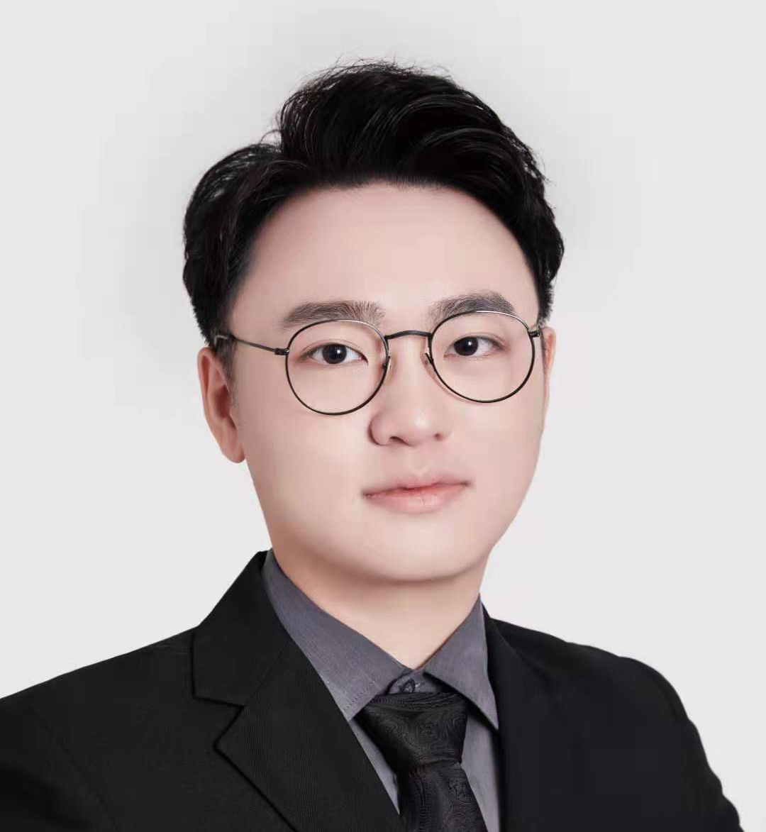

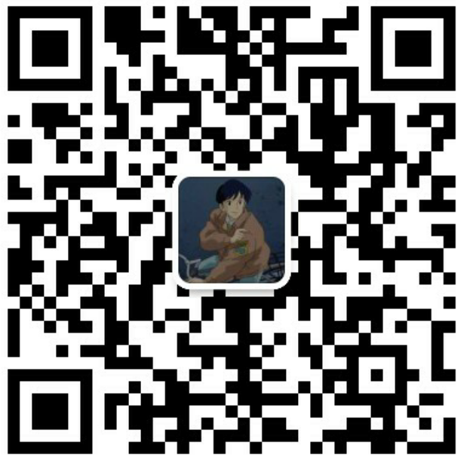
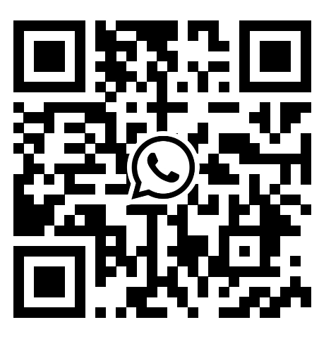



Thank you！
Q & A
Chen Lequn
PhD candidate
Advanced Remanufacturing and Technology Centre (ARTC), A*STAR, Singapore
School of Mechanical and Aerospace Engineering
Nanyang Technological University, Singapore
Contact: chen1470@e.ntu.edu.sg
Feel free to connect!

